Slide 1

HR ANALYTICS

Slide 2

HR Analytics: Insights and Recommendations
Understanding Attrition and Sales Performance

Slide 3

In today's competitive business landscape, organizations are constantly refining their recruitment strategies to attract top talent and enhance operational efficiency. The deliverables of our analysis encompass critical insights into the effectiveness of various recruiting channels in terms of attrition and sales performance.
Throughout this presentation, we will delve into:
A comparative analysis of attrition rates across different recruiting sources.
Insights into sales performance variations based on the recruiting channels utilized.
Actionable recommendations tailored to help organizations optimize resource allocation, refine recruitment strategies, and foster a high-performing workforce.
By understanding these deliverables, businesses can make informed decisions, allocate resources effectively, and ultimately achieve sustainable growth and success in talent acquisition and management.

Slide 4
Attrition Rates Across Recruiting Sources:
Our analysis found high attrition rates in 'Search Firm' and 'Campus' recruitment, signaling potential issues in candidate quality and selection processes
Patterns in Sales Performance Based on Recruiting Sources:
In our analysis, 'Search Firm' candidates displayed high sales performance despite high attrition, suggesting strong sales skills. 'Referrals' had stable attrition but lower sales impact, highlighting a retention versus sales effectiveness trade-off.
The effective Insightful patterns of various recruiting sources concerning attrition rates and sales performance.

Slide 5
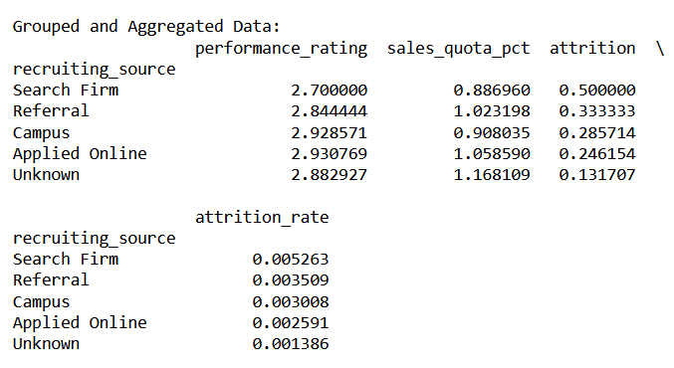
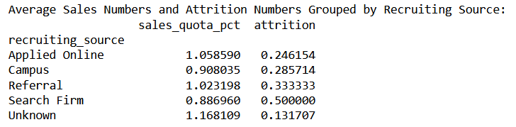
Average Sales numbers and average Attrition numbers, grouped by recruiting source:

Slide 6
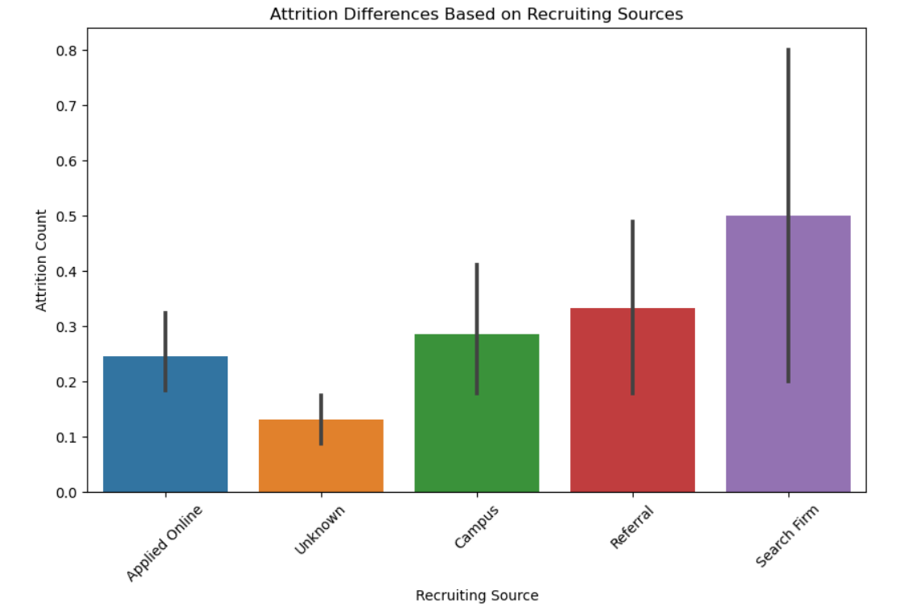
Higher Attrition Rates:
Higher attrition rate from 'Search Firm' may stem from candidate quality issues. These sources might offer a wide talent pool but may not always match organizational culture or job needs, leading to turnover. Candidates from external agencies or campus programs may exit early due to mismatched expectations, emphasizing the need for clear communication during recruitment

Slide 7
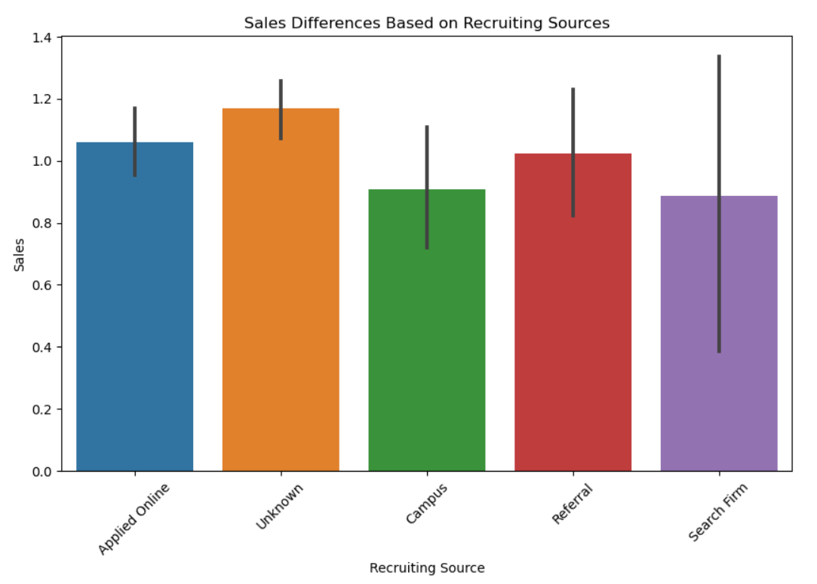
Sales Performance Disparities:
Sales performance differences in 'Search Firm' and 'Referrals' candidates may stem from varying skills and industry knowledge. Search firm hires often bring specialized skills, offsetting their higher turnover. Referrals, with lower turnover, may lack sales expertise and face cultural fit challenges affecting performance.

Slide 8
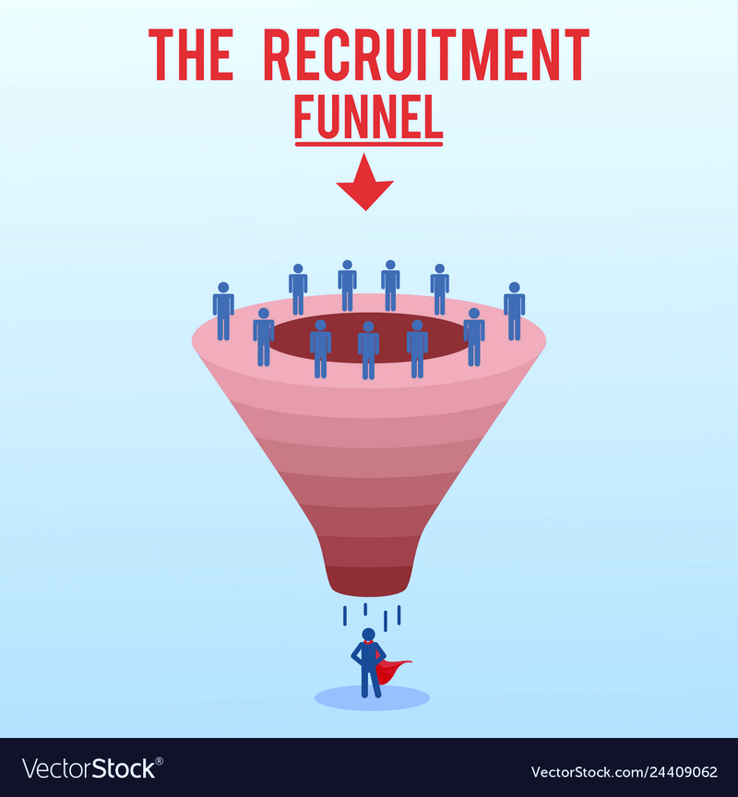
Recruitment Strategies:
To address disparities, organizations should target recruitment from sources with low attrition and high sales results. Implementing rigorous selection processes, such as assessments and behavioral interviews, can ensure candidates' skills, fit, and reduce early attrition, boosting sales performance

Slide 9

Recommendation: Prioritize 'Applied Online' and 'Referral' as they show low attrition and high sales impact. Candidates from these sources have the skills for sales success.
Justification: Our data links these sources to better sales performance, emphasizing quality in recruitment.
In conclusion, our analysis of recruiting sources' attrition rates and sales performance offers crucial insights into talent acquisition's strategic role in organizational success. Key takeaways include prioritizing quality in sources, making data-driven decisions, and recognizing the strategic importance of recruitment.

